Slide 1
Evaluating Election Schemes Under Strategic Voting
William Hawkins | CSCI 6967 | 20 APR 2023

Slide 2

What is the best voting scheme?
There are a plethora of proposed voting schemes in the discourse.

Slide 3
Importance of establishing a best voting scheme
Push for ranked voting in USA still has significant resistance.
Major argument of opposition is the ranked voting proponents can’t even agree on a method of ranked voting.
High consequences to choosing a ‘bad’ voting scheme.
Plurality voting is bad!

Slide 4
Previous Work
“A Precise Method for Evaluating Election Schemes” (Bordley)
Comparing strategic voting incentives in plurality and instant-runoff elections” (Eggers, Nowacki)

Slide 5
The Proposal
Evaluate the strength of various voting schemes according to some social welfare function.
Geometric Median
Geometric Mean
Evaluate the following schemes:
Plurality
Borda Count
Instant Runoff Voting
Single Random Ballot
Single Random Candidate

Slide 6
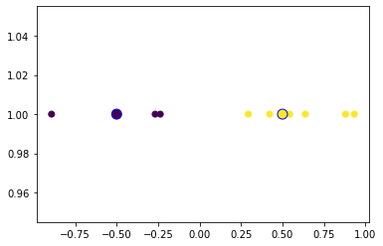
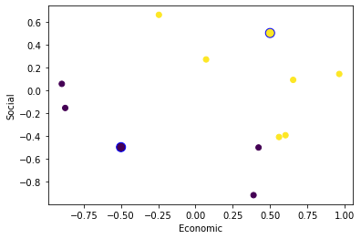
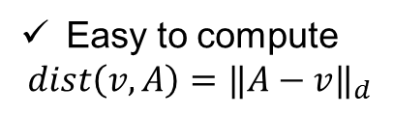
The Proposal: Voters in Euclidian Space
Easy to compute
$$dist\left(v,A\right)={‖A−v‖}_{d}$$

Slide 7
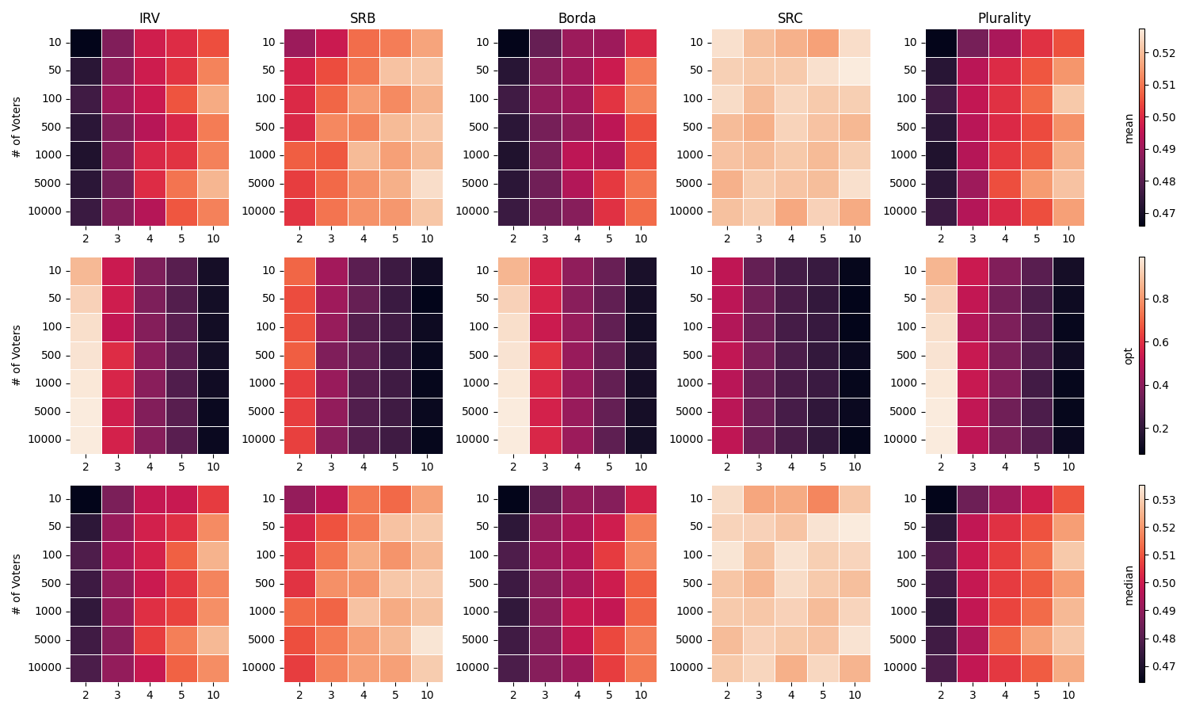
Results: # Voters v. # Alternatives

Slide 8
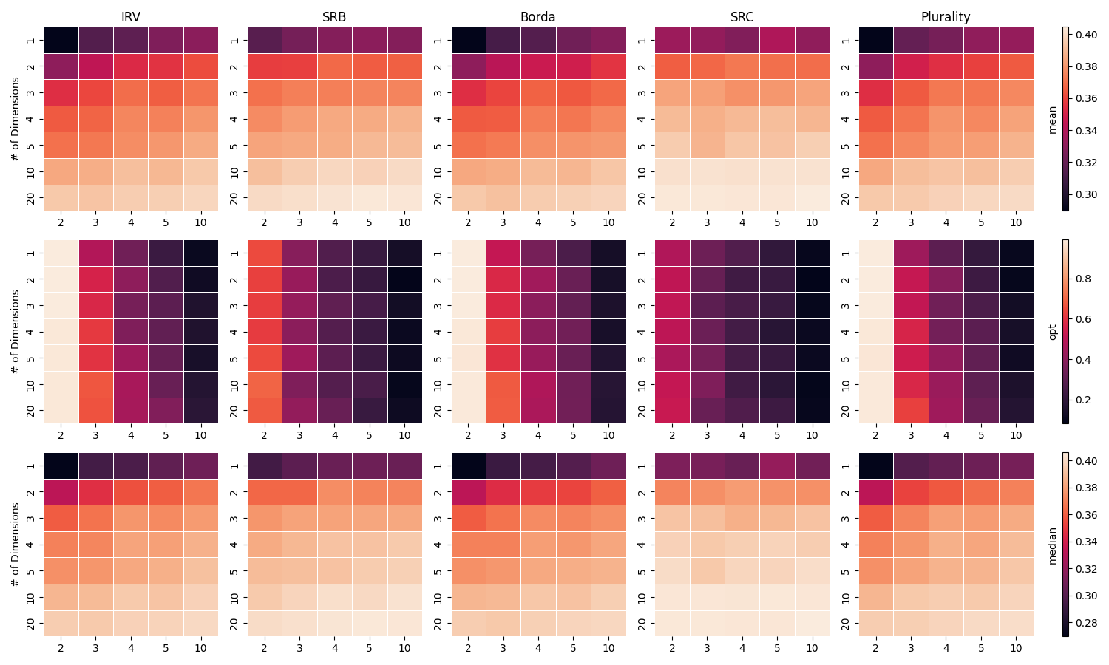
Results: # Dimensions v. # Alternatives

Slide 9
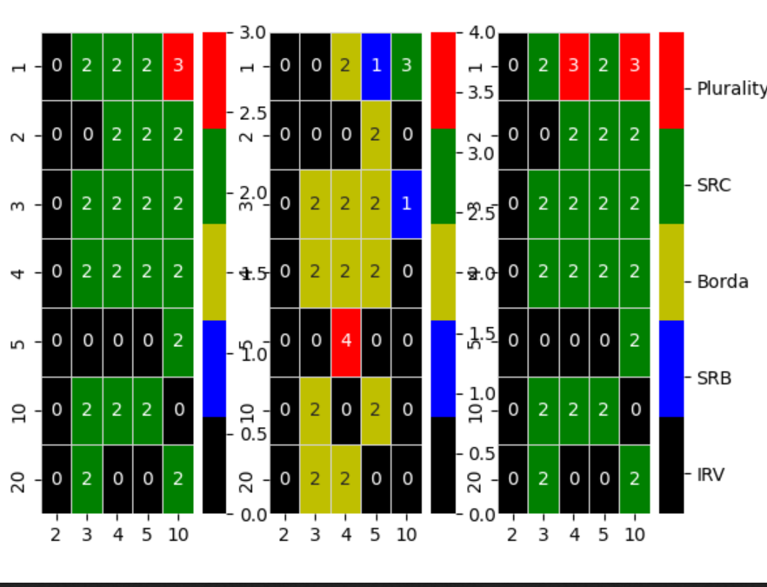
Results: # Dimensions v. # Alternatives

